Slide 1
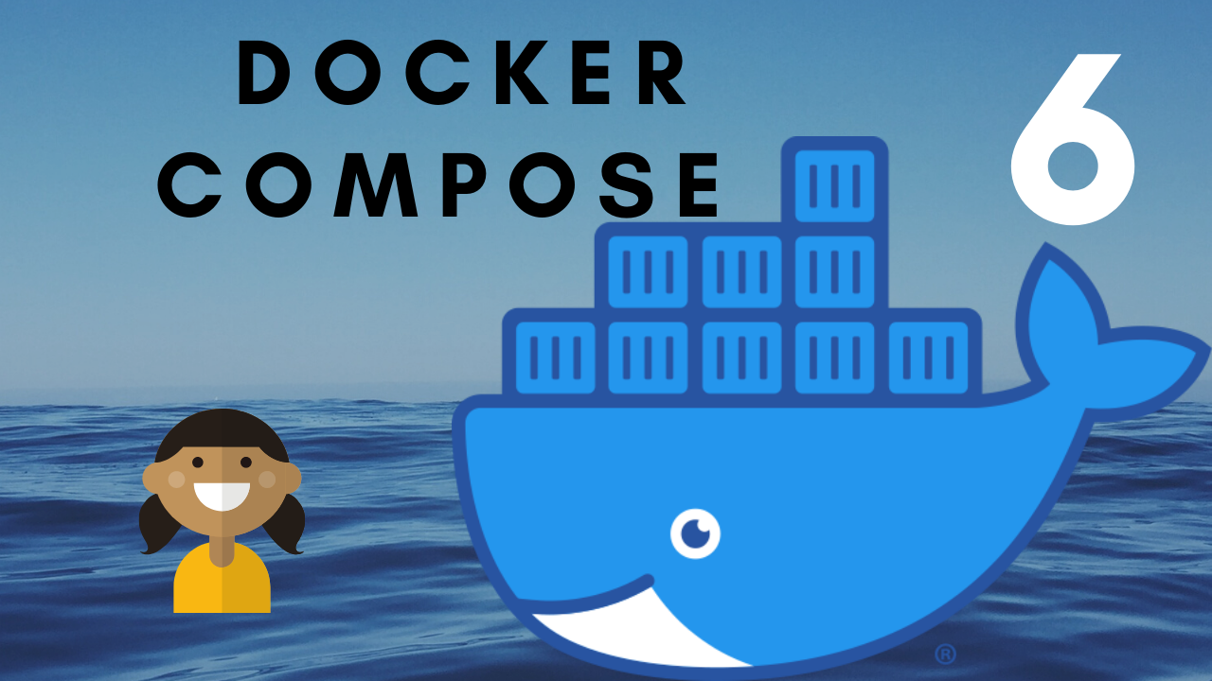

Slide 2



Slide 3
Docker Compose
Benefits of Docker Compose
How to use Docker Compose

Slide 4
Docker Compose
Tool for defining and running multi-container Docker application
It is Yaml file used to configure application services, network and volumes (docker-compose.yml)
Works in all environment (production, staging, development, testing and as well in CI workflows.
Can start all the services with ‘docker-compose up’ command
Can stop all the services with ‘docker-compose down’ command

Slide 5


Benefits of Docker Compose
Without Docker Compose
With Docker Compose
Build and run one container at a time.
Manually connect containers together.
Be careful with the dependencies and start up order
Define multi container app in yaml file. With single command to deploy entire application.
Works with Networking, Volume, Universal control Plane.
Handles container dependencies.

Slide 6
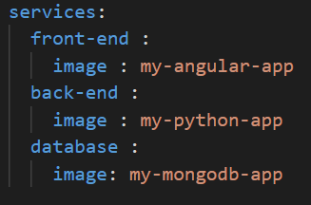

Use of Docker Compose
Docker compose is a 3 step process :
Define you app’s environment with a Dockerfile
Define the services that make up your app in Docker compose file
Run the CLI : docker-compose up

Slide 7


